Slide 1
EnerJ: Approximate Data Types for Safe and General Low-Power Consumption
BY: ADRIAN Sampson, Werner dietl, Emily fortuna, danushen gnanapragasam, luis ceze, dan grossman
Presented By: Alexander Perotti

Slide 2
Introduction
What is EnerJ?
Extension of Java which adds safe and general approximate data types
Isolates precise portions from approximate portions of a program
Motivation and Goals:
Provide programmers tools to use approximate and precise components safely
Guarantee safety statically to avoid energy-consuming checks at runtime
Energy savings in mobile devices and data-centers
Effects:
Small number of changes lead to 10%-50% energy savings

Slide 3
EnerJ
Uses qualifiers to indicate when data can be stored approximately and computations involving it can be performed approximately
Uses endorsements which are programmer specified points where approximate-to-precise data flow can occur
Supports programming constructs for algorithmic approximations where programmer produces different implementations for approximate or precise data
Provides generality to unify approximate data storage, approximate computation, and approximate algorithms with a single abstraction
The compiler, runtime system, and hardware are completely responsible for choosing energy-saving mechanisms, guaranteeing precision for precise data and “best effort” for approximate data

Slide 4
Type System for Approximate Computation
Enerj extensions of Java

Slide 5
Type Annotations
Every value has approximate or precise type given by annotations
Precise types are default and approximate must be explicit
Illegal to assign approximate value to precise value which prevents data flow from approximate to precise variables but precise to approximate is allowed via primitive subtyping

Slide 6
Endorsement
Allows for approximate data to break the separation enforced by the type system by acting as a cast
Explicit static function endorse allows approximate data to be used as if it were precise
May cause implicit runtime effects, such as, copying values from approximate to precise memory

Slide 7
Approximate Operations
EnerJ provides two signatures for operators such as “+”
Approximate + Approximate = Approximate
Precise + Precise = Precise
Operators on approximate values can take place on approximate, low-power hardware
Provides bidirectional type-checking
Precise + Precise = Approximate overloads the approximate addition operator without having to cast precise to approximate

Slide 8
Control Flow
EnerJ prohibits approximate values in conditions that affect control flow (i.e. if and while statements)
The following example would not be allowed since val is an approximate int
While this is conservative, a programmer could circumvent this by simply using if(endorse(val == 5))

Slide 9
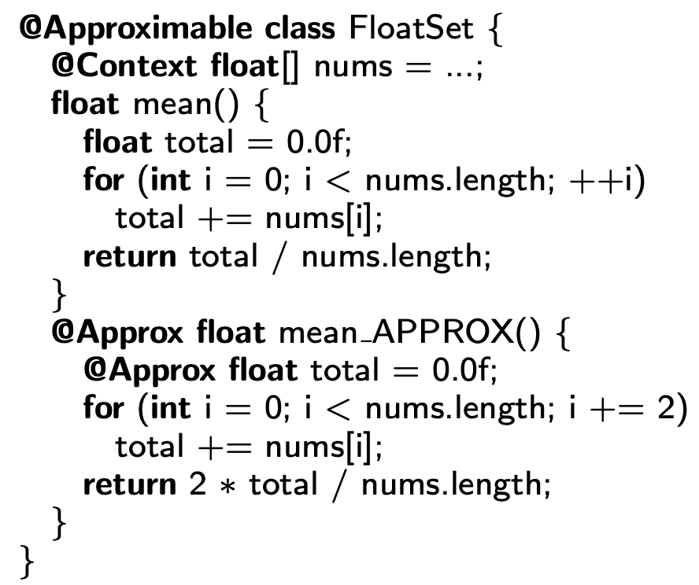
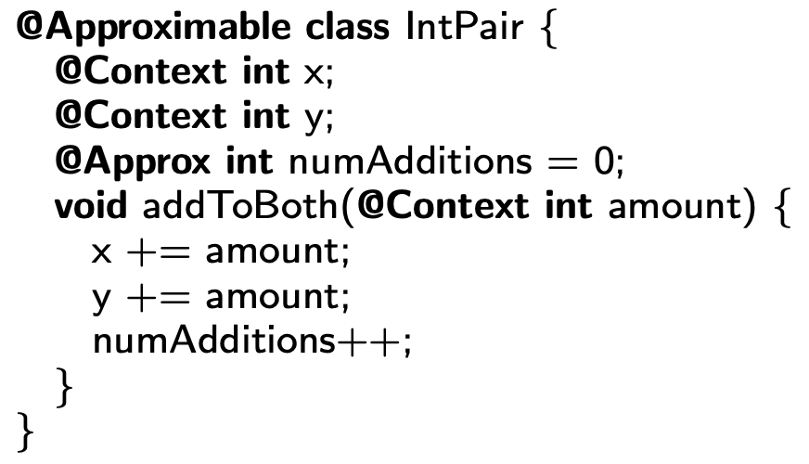
Objects
EnerJ supports approximate classes using the qualifier @Approximable
Using polymorphism clients can create precise or approximate instances
Keyword @Context allows parameter precisions to be determined by the instance of the class
Allows for two implementations of a method depending on the precision of the class instantiation using keyword _APPROX
This allows for backwards compatibility because a plain JAVA complier will always use the precise function

Slide 10
Arrays
Approximate element types are allowed but array length is kept precise for memory safety
Array indexing must use precise data types to prevent out-of-bounds exceptions caused by approximation

Slide 11
Formal Semantics
FEnerj Semantic Experimentation

Slide 12
FEnerJ
Created FEnerJ to explore the formal semantics of EnerJ
Minimal language based on Featherweight Java
Omits endorsements to guarantee precise and approximate separations
Explores subtyping, context adaptation, type rules
Proves:
EnergJ’s lack of guarantees for approximate values
Type soundness
Non-interference (changing approximate values in the heap or runtime environment does not change the precise parts of the heap or computation result)

Slide 13
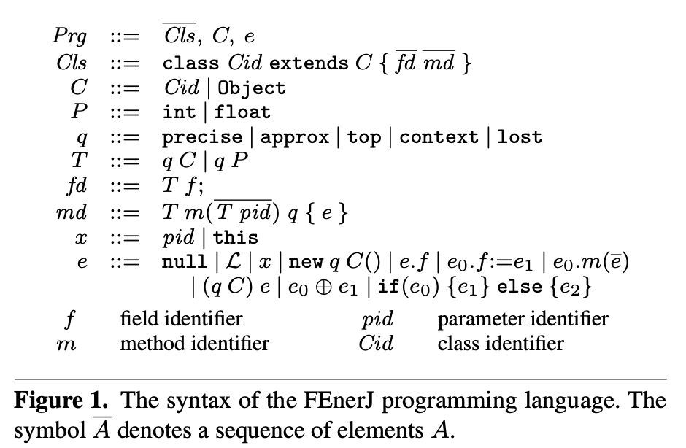
FEnerJ
Proof of Statement #1
Proof of Statement #2
Proof of Statement #3

Slide 14
Execution Model
Enerj Possible applications

Slide 15
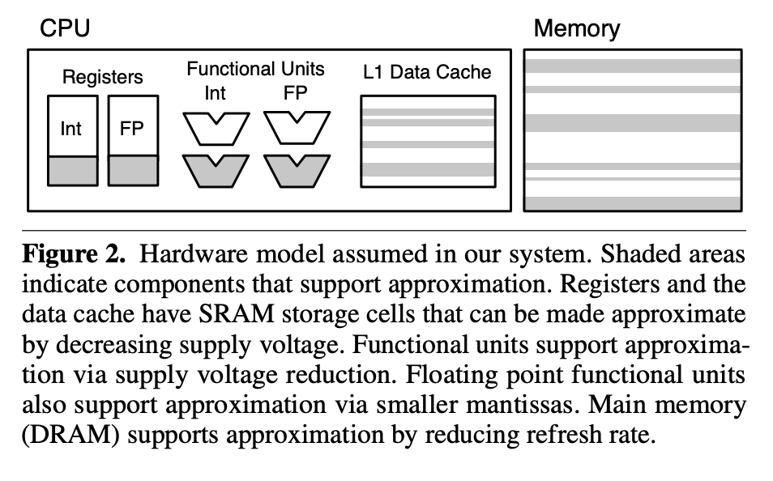
EnerJ Execution
EnerJ distinguishes abstractly between approximate and precise data but does not define approximation strategies to apply
Researchers chose to examine architecture level approximation but claim EnerJ could work with approximate execution features

Slide 16
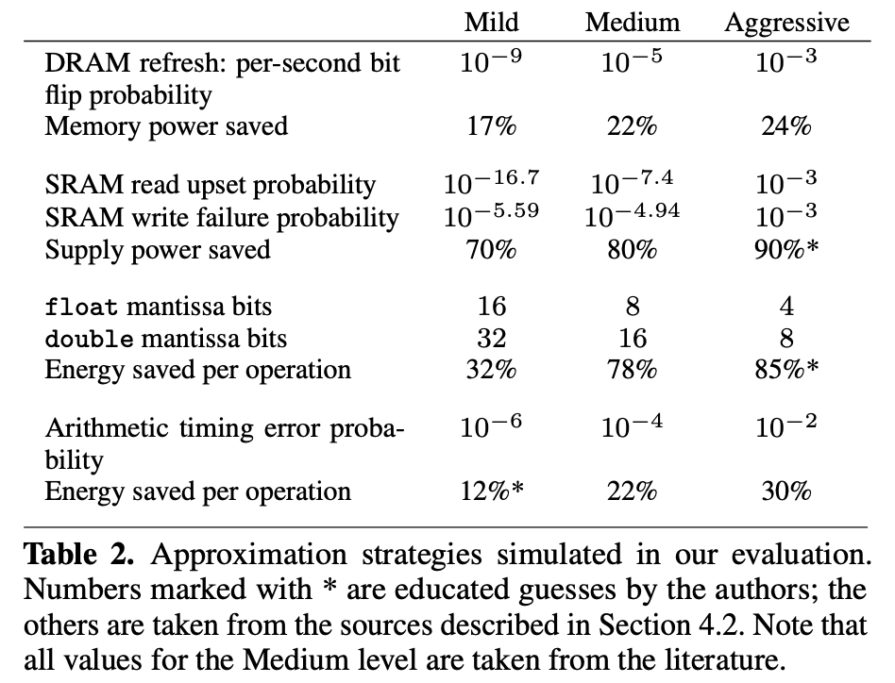
Hardware Techniques for Saving Energy
Voltage Scaling in logic circuits
Width reduction in floating point operations
DRAM refresh rate
SRAM supply voltage

Slide 17
Implementation
Enerj application

Slide 18
EnerJ Testing
Implemented using a simulation infrastructure to emulate the approximate computing architecture outlined in Figure 2
Simulation included method calls, object creation and destruction, arithmetic operators, memory accesses, fault injections
Approximations:
Floating-point bit-width reductions performed on arithmetic operators
SRAM read/write failures simulated by probabilistically flipping bits
DRAM bits each had probability to be inverted
Energy evaluation assumptions:
Assigned abstract energy units to arithmetic operations and calculated energy savings of non-fetch, non-decode segments of int and float calculations
SRAM assumed to consume 35% of microarchitecture power consumption
DRAM assumed to consumer 45% of overall usage when added to CPU consumption

Slide 19
Experiment Results
Enerj Simulation Evaluation

Slide 20
EnerJ Evaluation Metrics
Annotated benchmark applications manually in a way which never causes crashes while striving to balance reliability and energy savings

Slide 21
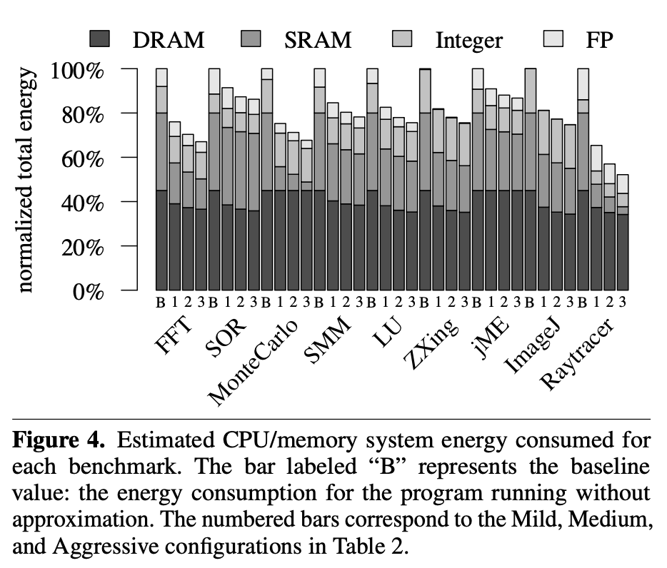
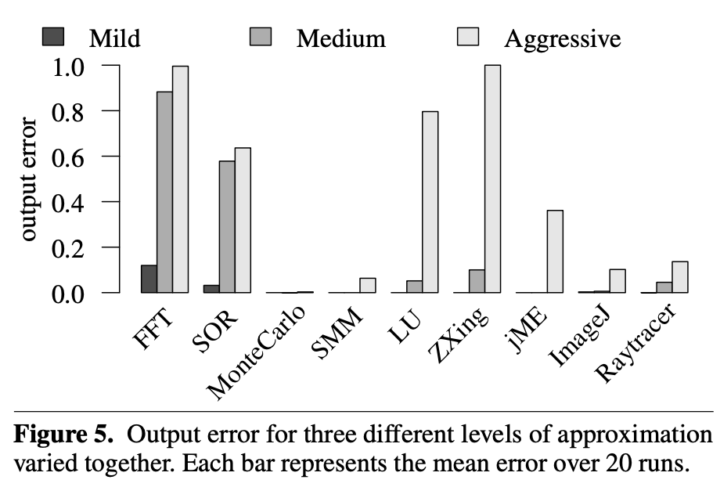
EnerJ Results

Slide 22
Result Summary
The majority of the energy savings come from the transition from zero approximation to mild approximation with very small losses to output fidelity in all applications
Principle data acceptable for annotations is concentrated in a small part of the code although it dominates the program behavior
Classes that closely represent data are best for @Approximable annotations
@Context greatly improved practicality since classes can be used in either approximate or precise applications

Slide 23
Questions?

Slide 24
Exam Questions
EnerJ is an extension of which programming language?
C++
Java
Python
C
Within EnerJ’s application, what two keywords are used to distinguish data types?
@Approx
@Fusion
@Precise
@Saver
EnerJ program distinguishes abstractly between approximate and precise data, it does not define the particular approximation strategies that are applied to the program.
True
False

